Slide 1


Internship Application & Progress Monitoring System
DBMS Project — Phase 2 / Review 2: Implementation, Schema Validation & Query Execution
Presenter: Martala Harsha Vardhan Reddy | Roll No: 25WU0102152
School of Technology, Woxsen University
Notes:
1

Slide 2
Review 2 — Scope & Core Objectives
Four deliverables define this review phase.
System Implementation
Referential Integrity
Execute SQL DDL scripts to instantiate 7 relational tables with precise data types and constraints.
Apply ON DELETE CASCADE, RESTRICT, and SET NULL actions across entities.
Sample Data Ingestion
Query Verification
Populate realistic university placement and internship logs across all entities.
Execute multi-table JOINs, weak entity traversals, and aggregations.
Notes:
2

Slide 3
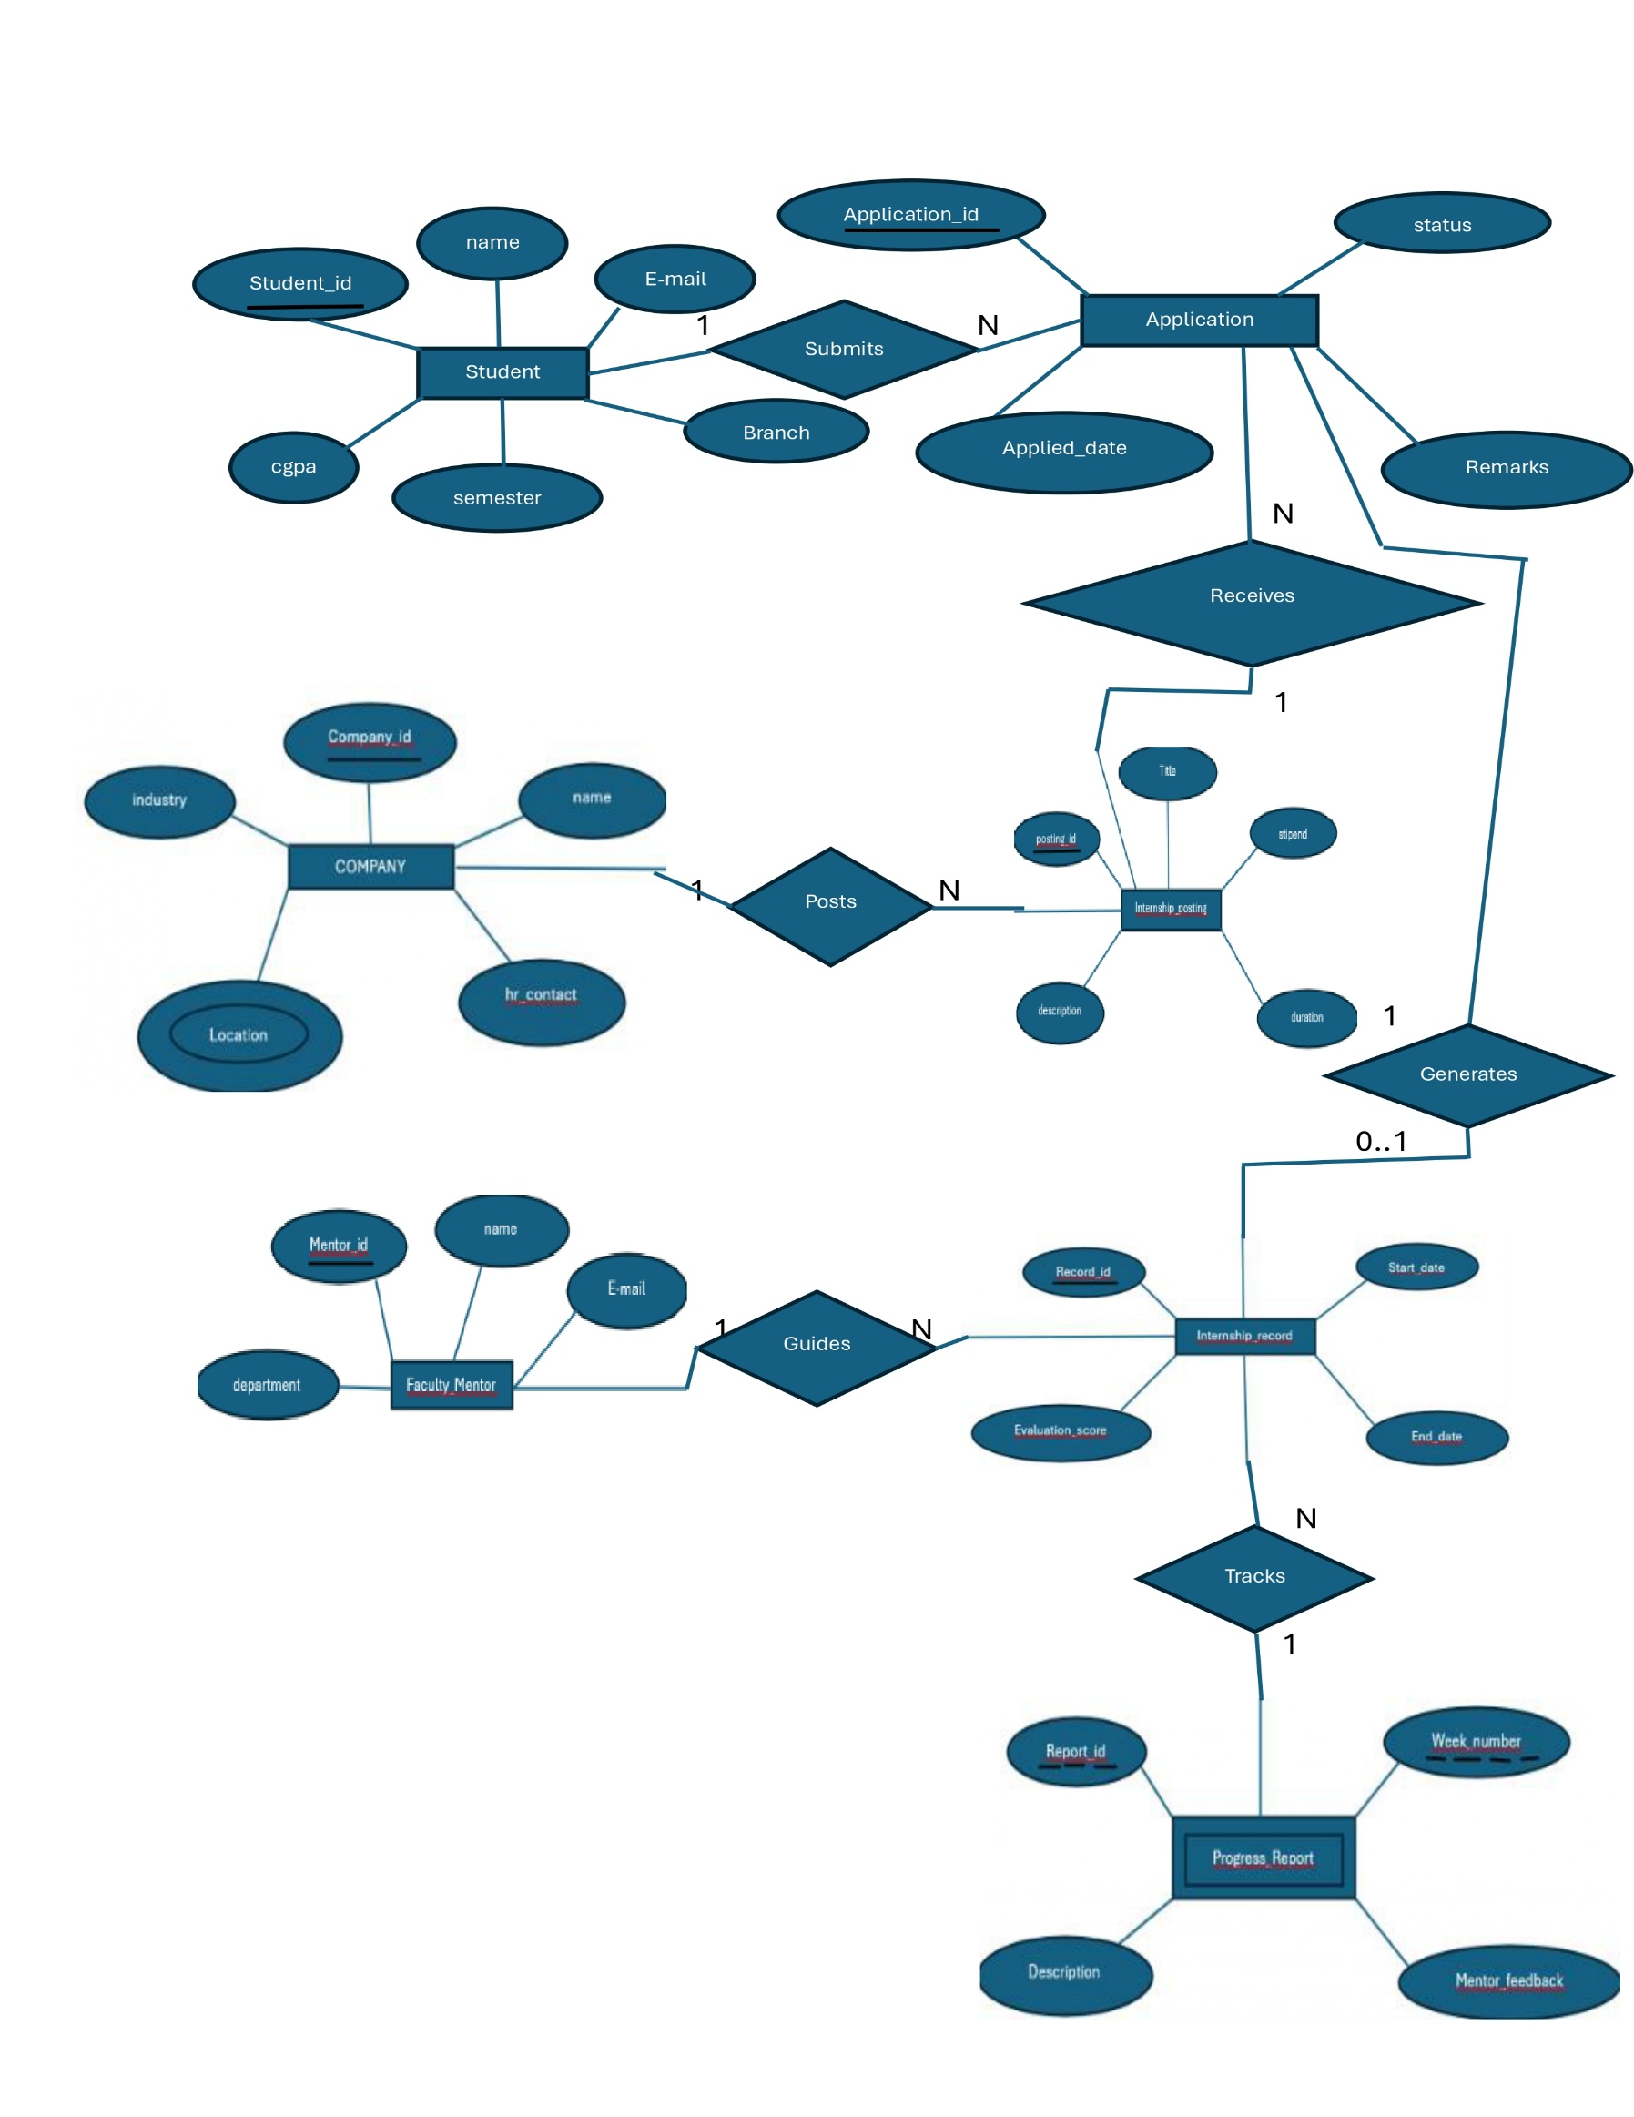
Finalised Entity-Relationship Model
Seven entities mapped using Chen's notation with two key modelling decisions:
  Weak Entity — Progress_Report: Identified by Internship_Record via the Tracks relationship; week_num serves as the partial key.
  Conditional Cardinality — Generates: Application to Internship_Record enforces a 1 to 0..1 optional constraint for accepted applications only.
  Total Participation: Progress_Report is fully dependent on Internship_Record in the Tracks relationship.
Notes:
3

Slide 4
Relational Schema & Integrity Constraints
Seven tables with primary keys, foreign keys, and referential actions.
Table | Primary Key | Foreign Keys & Referential Actions | Constraints
Student | student_id | — | email UNIQUE NOT NULL
Company | company_id | — | name NOT NULL
Faculty_Mentor | faculty_id | — | email UNIQUE NOT NULL
Internship_Posting | posting_id | company_id → Company (SET NULL) | —
Application | application_id | student_id → Student (RESTRICT), posting_id → Posting (CASCADE) | —
Internship_Record | record_id | application_id → Application (CASCADE), faculty_id → Mentor (SET NULL) | —
Progress_Report | (record_id, week_num) | record_id → Internship_Record (CASCADE) | week_num is discriminator
Notes:
4

Slide 5
SQL DDL Implementation
Master Entity — Student
Weak Entity — Progress_Report
CREATE TABLE Student (
student_id VARCHAR(15) PRIMARY KEY,
name VARCHAR(100) NOT NULL,
email VARCHAR(100) UNIQUE NOT NULL,
program VARCHAR(50),
semester INT,
cgpa DECIMAL(3, 2)
);
CREATE TABLE Progress_Report (
record_id VARCHAR(15) NOT NULL,
week_num INT NOT NULL,
description TEXT NOT NULL,
mentor_feedback TEXT,
PRIMARY KEY (record_id, week_num),
FOREIGN KEY (record_id)
REFERENCES Internship_Record(record_id)
ON DELETE CASCADE
);
Notes:
5

Slide 6
Master Entity Data Population
Entity | ID | Name / Title | Domain / Program | Additional Info
Student | S101 | Harsha Vardhan | B.Tech CSE, Sem 3 | CGPA 8.85
Student | S102 | Ananya Sharma | B.Tech CSE, Sem 3 | CGPA 9.10
Company | C201 | TechCorp Labs | Software, Hyderabad | hr@techcorp.com
Company | C202 | DataPulse AI | Analytics, Bengaluru | jobs@datapulse.io
Faculty_Mentor | F301 | Dr. Dharmendra Mishra | CSE Department | mishra@univ.edu
Faculty_Mentor | F302 | Dr. K. Rao | CSE Department | rao@univ.edu
Notes:
6

Slide 7

Transactional Entity Data Population
Applications & Placement Record
Progress Reports — Weak Entity Records
ID | Date | Status | Student | Posting
A501 | 2026-08-10 | Accepted | S101 | P401
A502 | 2026-08-12 | Pending | S102 | P402
Record | Week | Details
R601 | Week 1 | Schema setup completed | Feedback: Approved
R601 | Week 2 | REST routes connected | Feedback: Needs indexing
Record R601: 2026-09-01 to 2026-11-30 | Ongoing | Application A501 | Mentor F301
Each Progress_Report row is existence-dependent on Internship_Record R601 — deletion cascades automatically.
Notes:
7

Slide 8
QUERY EXECUTION 1
Multi-Table JOIN — Active Internship View
Objective
Result
Retrieve active internships with student, company, and mentor details across five tables.
Student | Company | Role
Harsha Vardhan | TechCorp Labs | Backend Intern
Mentor | Status | —
Dr. Dharmendra Mishra | Ongoing | —
SELECT s.name AS student_name,
c.name AS company_name,
p.title AS role,
f.name AS mentor_name,
r.final_status
FROM Internship_Record r
JOIN Application a
ON r.application_id = a.application_id
JOIN Student s
ON a.student_id = s.student_id
JOIN Internship_Posting p
ON a.posting_id = p.posting_id
JOIN Company c
ON p.company_id = c.company_id
LEFT JOIN Faculty_Mentor f
ON r.faculty_id = f.faculty_id;
Notes:
8

Slide 9

QUERY EXECUTION 2
Weak Entity Traversal & Aggregations
Query A — Progress Log by Week
Query B — Applicants per Company
SELECT s.name, pr.week_num,
pr.description, pr.mentor_feedback
FROM Progress_Report pr
JOIN Internship_Record r
ON pr.record_id = r.record_id
JOIN Application a
ON r.application_id = a.application_id
JOIN Student s
ON a.student_id = s.student_id
WHERE s.student_id = 'S101'
ORDER BY pr.week_num ASC;
SELECT c.name AS company_name,
COUNT(a.application_id) AS total_applicants
FROM Company c
JOIN Internship_Posting p
ON c.company_id = p.company_id
LEFT JOIN Application a
ON p.posting_id = a.posting_id
GROUP BY c.company_id, c.name;
LEFT JOIN ensures companies with zero applications are still included in the result set.
Notes:
9

Slide 10





Phase 3 — Final Review Roadmap
Full-Stack Integration
Build RESTful API endpoints connecting backend controllers to the normalised schema.
Database Triggers
Auto-generate an Internship_Record row whenever an Application status changes to 'Accepted'.
Security & Access Control
Enforce role-based access for Students, Mentors, and Companies.
Performance Tuning
Add indexes on foreign keys (student_id, posting_id, record_id) and evaluate execution plans.
Notes:
10

